Slide 1


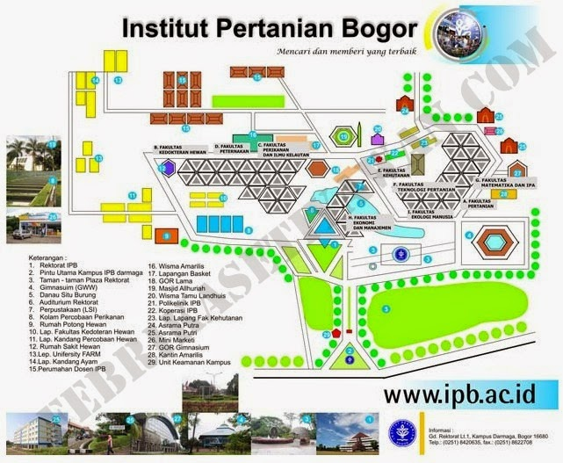

Trend Emisi Sektor Energi dan Transportasi IPB
IPB University
"Zero Waste, Zero Emission, Rich in Bio-and Cultural-diversity"

Slide 2

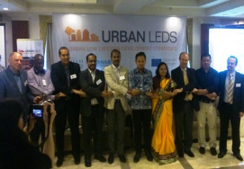
Roadmap of LC Campus Scenario Modelling with Monitoring
We have developed model and LCS scenarios in IPB with available data and current policy initiatives.
The scenario will be updated with ongoing monitoring data and survey results
Sep-Dec 2018
Dec 2018-Jan 2019
Available data
Modeling
Monitoring & analysis
Energy saving potential of buildings in IPB Campus
Data pembayaran listrik
Inventarisasi peralatan listrik
Energy consumption pattern in IPB Campus
Questionnaire survey
Modeling
Preliminary
Scenario
Energy consumption
Awareness on energy and environment
Transportation behavior
Updated
Scenario
Current policy programs
Number of students and faculty & economy
Transport volume
Waste generation
Actions and Candidates
of Policy Programs
Projection with monitoring data
GHG emission reduction potential considering local characteristics in IPB Campus
Energy demand
Energy demand
Land-use change
Emission reduction

Slide 3
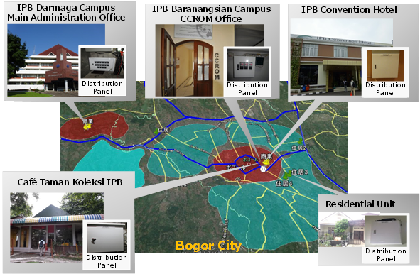
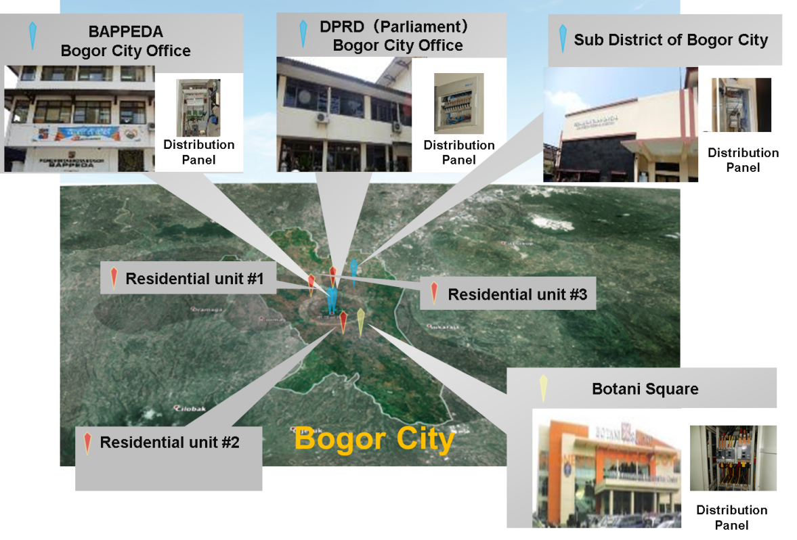
Energy Monitoring
2014, CCROM-IPB supported with NIES, start to study the behavior of Bogor city and IPB Campus energy consumption
  Base line data for the future energy policy
Electricity consumption in many points of offices, commercials, houses of Bogor city and IPB campus have been monitored:
  System provided by Fujitsu and Fuji electric
Limitation
  At Dramaga campus, the monitoring system in only installed at the Rectorate Office
  Additional energy monitoring system for Darmaga Campus is designed by IPB to complement the Fujitsu and Fuji Electric

Slide 4
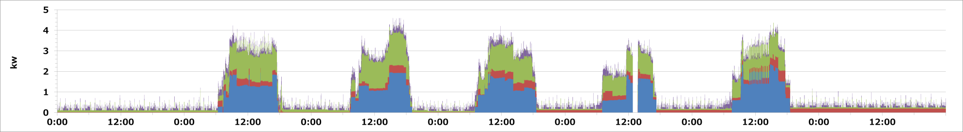
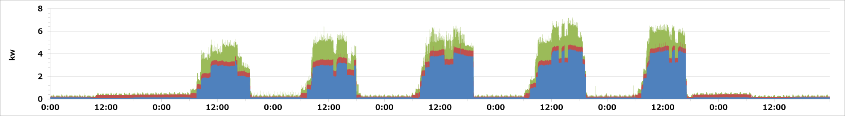
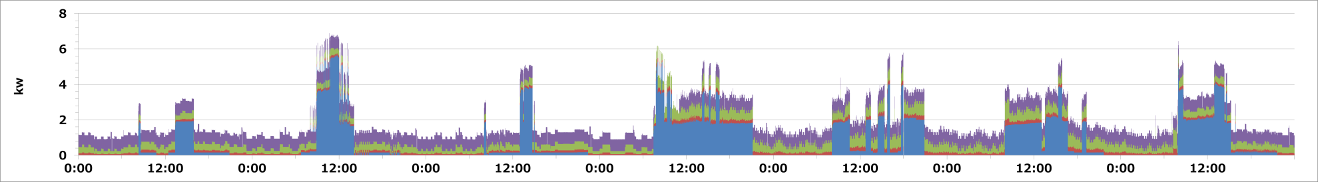
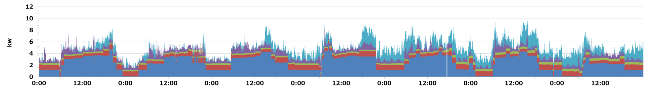
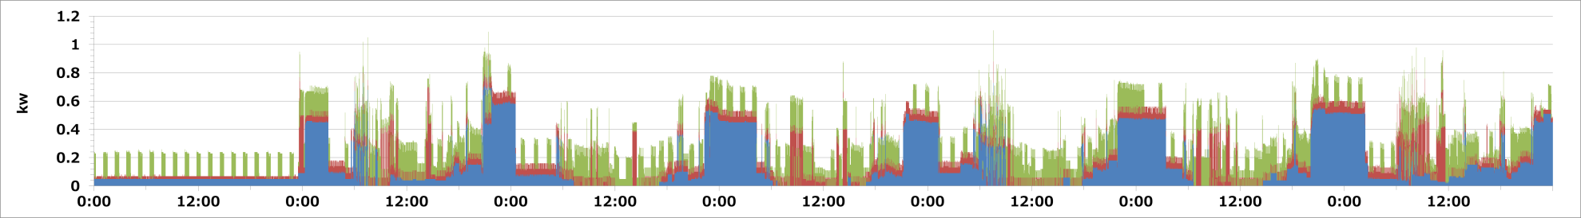
Weekly Monitoring Data in Bogor City
AC
Refrigerator
Lighting
Receptacle
Sun
2/28
Mon
2/29
Tue
3/1
Wed
3/2
Thu
3/3
Fri
3/4
Sat
3/5
Office
Sun
2/28
Mon
2/29
Tue
3/1
Wed
3/2
Thu
3/3
Fri
3/4
Sat
3/5
Government
Sun
2/28
Mon
2/29
Tue
3/1
Wed
3/2
Thu
3/3
Fri
3/4
Sat
3/5
Cafe
Sun
2/28
Mon
2/29
Tue
3/1
Wed
3/2
Thu
3/3
Fri
3/4
Sat
3/5
Hotel
Sun
2/28
Mon
2/29
Tue
3/1
Wed
3/2
Thu
3/3
Fri
3/4
Sat
3/5
House
hold
Electricity consumption by air-conditioners is high in all monitored sites
4

Slide 5
Monitoring of Electricity Consumption for designing strategy for reducing emission
Identify target area
Select scenario
Monitor energy use
Evaluate impact of the scenarios
Processed and analyze the data
Identify main sources of energy consumption
Design scenarios

Slide 6
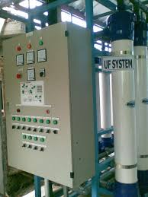
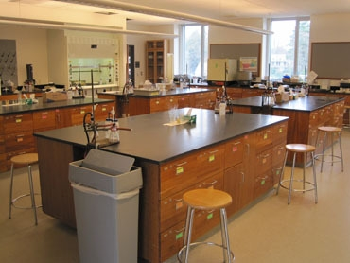
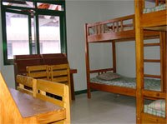
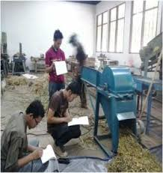
Measures to reduce emissions from electricity consumption at IPB Campus
Identify target area
Monitor energy use
Campus facilities that consume most of campus electricity need to be studied (monitored)
Processed and analyze the data
Identify main source of energy consumption
Design scenarios
Evaluate impact of the scenarios
Select scenario

Slide 7
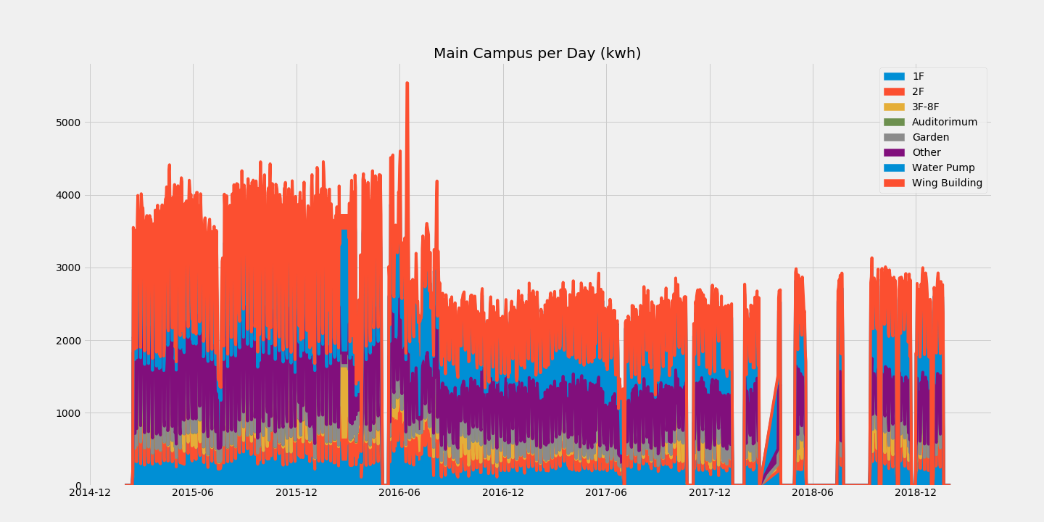
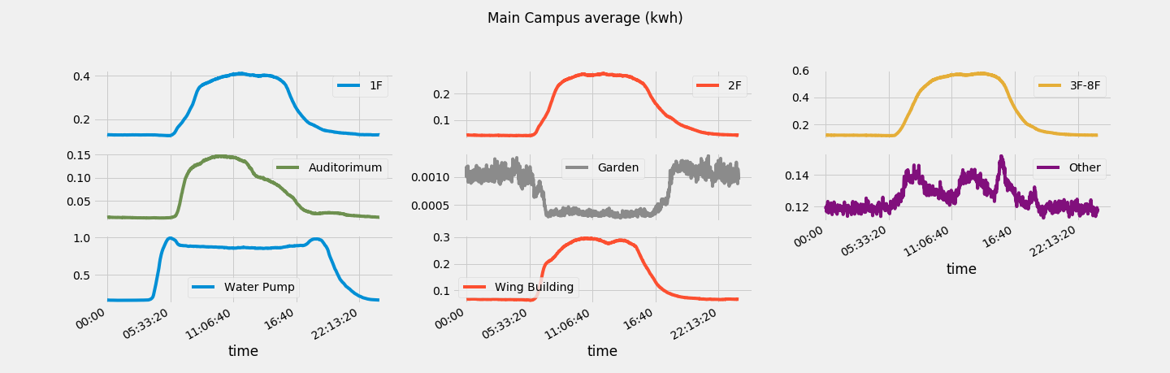
Energy Monitoring at Rectorate IPB
Identify target area
Monitor energy use
Processed and analyze the data
Identify main source of energy consumption
Design scenarios
Evaluate impact of the scenarios
Select scenario

Slide 8
Energy Monitoring at Rectorate IPB
Identify target area
Monitor energy use
Processed and analyze the data
Identify main source of energy consumption
Design scenarios
Evaluate impact of the scenarios
There is a significance increase on the use of energy at Rectorate at 6 am to 8 pm, mainly due to the increase use of energy for air conditioning
Select scenario

Slide 9
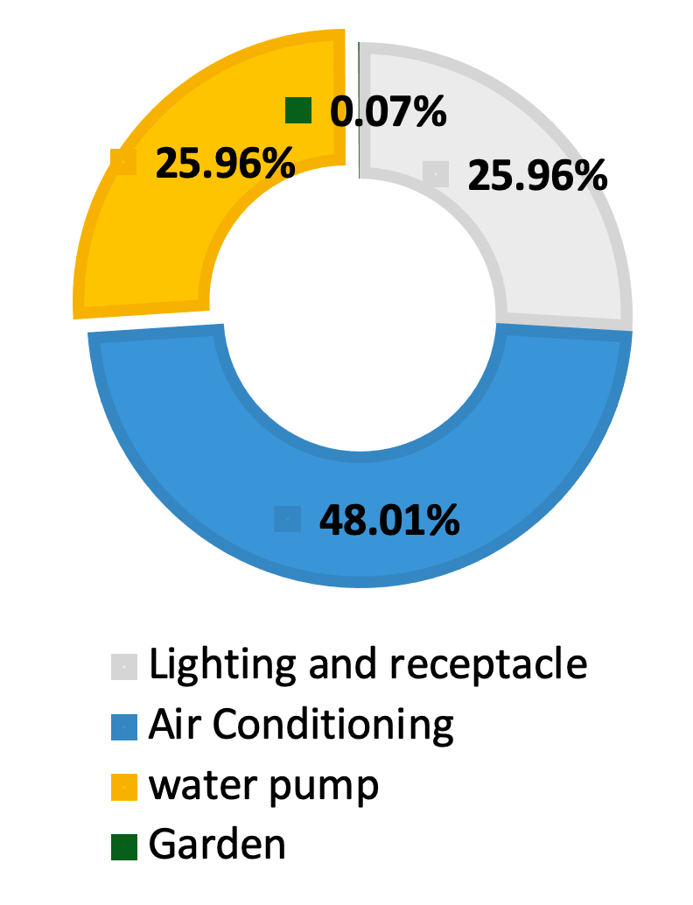
Measures to reduce emissions from electricity consumption at IPB Campus
Identify target area
Main source of energy consumption
Monitor energy use
Processed and analyze the data
Main source of energy consumption is Air conditioning
Identify main source of energy consumption
Design scenarios
Evaluate impact of the scenarios
Select scenario

Slide 10
Measures to reduce emissions from electricity consumption at IPB Campus
Identify target area
Scenarios
Technology options
Replacement of lights that will improved efficiency of 70%
Replacement of air conditioning that will improve efficiency of 17%
Monitor energy use
Processed and analyze the data
Identify main source of energy consumption
Scenario name | Lighting | Air conditioning
BAU
S1 | 100% replacement | None
S2 | None | 100% replacement
S3 | 50% replacement | 50% replacement
Design scenarios
Evaluate impact of the scenarios
Select scenario

Slide 11
Measures to reduce emissions from electricity consumption at IPB Campus
Identify target area
Scenarios
Behavior measures
Policy for limiting use of AC during peak hours (5-10 pm)
Policy for limiting use of certain appliance during off-peak hours
Monitor energy use
Processed and analyze the data
Identify main source of energy consumption
Scenario name | Peak hour | Off Peak hours
S4 | 25% reduction | None
S5 | None | No air conditioning between 8 pm – 6 am
S6 | 10% reduction | No air conditioning between 10 pm – 5 am
S7 | 10% reduction | 10% reduction
Design scenarios
Evaluate impact of the scenarios
Select scenario

Slide 12
Measures to reduce emissions from electricity consumption at IPB Campus
Evaluating Impact
Identify target area
Monitor energy use
Processed and analyze the data
Technology option
Identify main source of energy consumption
Behavioral measures
Design scenarios
Evaluate impact of the scenarios
In general, Scenario 4 resulted in lower reduction compare to other scenarios
Scenario 2 generates lower consumption, in Technology option but, scenario 6 is the best scenario generates low consumption
Select scenario

Slide 13
Measures to reduce emissions from electricity consumption at IPB Campus
Evaluating Impact
Identify target area
Monitor energy use
Processed and analyze the data
Identify main source of energy consumption
Design scenarios
Evaluate impact of the scenarios
Select scenario

Slide 14
Recapitulation of cost for electricity at IPB in 2019
NAMA PELANGGAN | ID PELANGGAN | Bulan | Tot. KWh | Σ bayar | Emisi | Emisi Skenario
 |  |  |  |  |  | S4 (low) | S6 (high)
Gedung FAK KAN NAK | 538311645719 | Jan-19 | 618,978 | 684,130,404 | 521,798 | 502,923 | 255,069
 |  | Feb-19 | 126,700 | 688,463,590 | 106,808 | 102,944 | 52,211
 |  | Mar-19 | 52,991 | 672,479,647 | 44,671 | 43,055 | 21,837
 |  | Apr-19 | 565,503 | 719,868,921 | 476,719 | 459,474 | 233,033
 |  | May-19 | 564,678 | 714,125,003 | 476,024 | 458,804 | 232,693
Based on the electricity cost of 2019, if the scenario S4 (low scenario) and S6 (high scenario) were used, the emission reduction will be 11,764 and 166,235 kgCO2/month respectively.
Data with yellow highlight need evaluation

Slide 15
Measures to reduce emissions from electricity consumption at IPB Campus
Selection of Scenarios
Identify target area
Monitor energy use
Consideration can be based on, among others:
Least cost (total)
Highest emission reduction
Highest emission reduction/cost, especially for technology based
Processed and analyze the data
Identify main source of energy consumption
Design scenarios
Evaluate impact of the scenarios
Select scenario

Slide 16
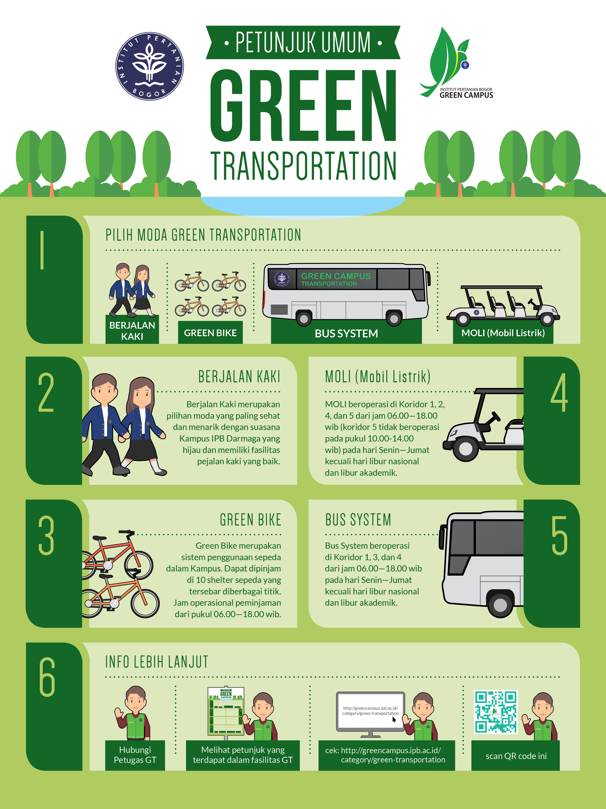
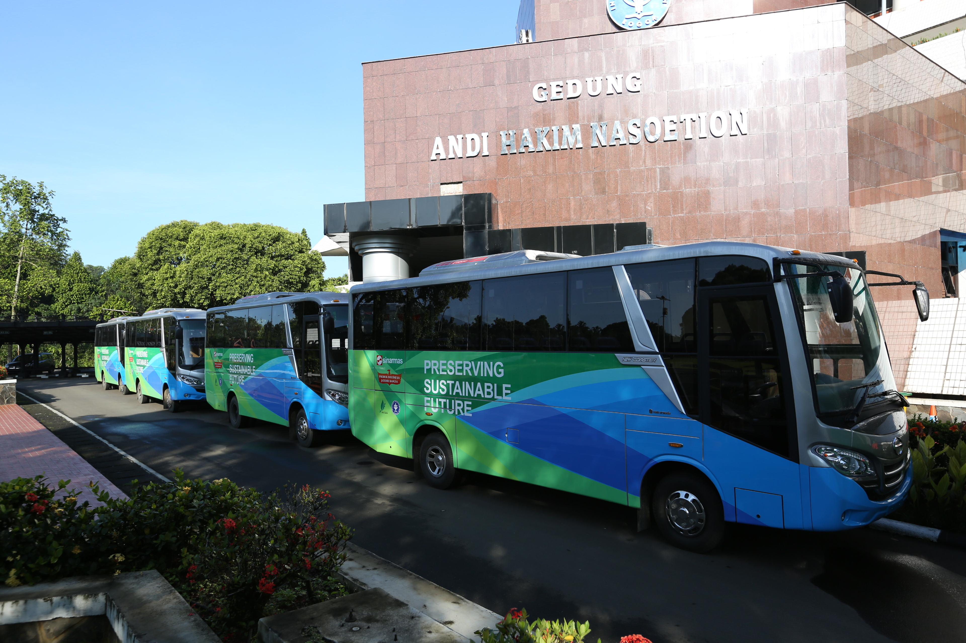
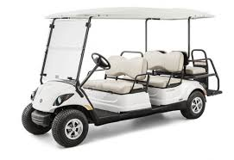
Transportation

Slide 17
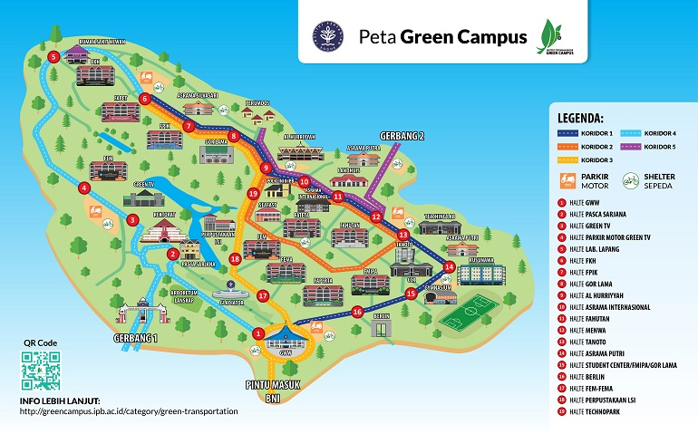
Ritase
Rata-rata perhari
Bus 22; Moli 12
Assumption of BaU developed based on survey
Bus 40%
Car 20%
Motor cycle 40%
Green transportation policy (Bus and Moli)
Reduce the use motor cycle in campus with increasing bus system
Reduce the use of BBM due to the use of Moli

Slide 18
Ritase
Rata-rata per hari
Bus 22; Mobil listrik (Moli) 12
533 kg CO2/month

